Slide 1





SMART FLIGHT INFORMATION SYSTEM
Introduction to Robotic Process Automation
Your Register No: 220701208 Name: Radhika Rakesh
Guide Name: Dr. N.Duraimurugan
Designation and Department

Slide 2
Abstract
The "Smart Flight Information System" leverages Robotic Process Automation (RPA) using UiPath to automate flight data retrieval and presentation. It simplifies the process of gathering flight schedules, airlines, and prices based on user inputs like travel dates and destinations. The system ensures accuracy, reduces manual effort, and provides organized, real-time outputs. Designed to enhance efficiency and user experience, it addresses challenges of manual searches, including errors and time consumption, showcasing the transformative potential of RPA in the travel industry.

Slide 3
Need for the Proposed System
Time-Consuming Process: Manual flight searches require significant effort and time.
Prone to Human Errors: Manual data entry and misinterpretation
can result in inaccuracies.
Inconsistent Formatting: Flight details across different sources vary in presentation, complicating comparison.
Limited Scalability: Handling multiple searches for various destinations is challenging without automation.
The proposed system overcomes these challenges by providing an efficient, accurate, and scalable solution using RPA to automate flight information retrieval and presentation.

Slide 4
Advantages of the Proposed System
Time Efficiency: Automates repetitive tasks, significantly
reducing the time needed to retrieve flight information.
Accuracy: Ensures consistent and error-free data retrieval.
Scalability: Handles multiple searches across various
destinations simultaneously.
User Experience: Provides clear, concise, and well- organized outputs to facilitate easy decision-making.
Reliability: Incorporates robust error-handling mechanisms to adapt to changes in website interfaces.

Slide 5
Literature Survey
Paper 1: Robotic Process Automation (RPA) has proven effective in handling repetitive tasks in the travel and tourism sector. Studies emphasize its ability to automate flight data retrieval, improving accuracy, reducing human errors, and saving time. Tools like UiPath incorporate machine learning for adaptive web scraping, making automation more reliable. However, challenges such as dynamic website changes and ethical concerns related to data privacy persist.
Advantages: Enhances efficiency by automating time-consuming tasks.
Provides accurate and consistent data with minimal
Disadvantages: Faces difficulties with frequent changes in website layouts.
Ethical concerns regarding web scraping.

Slide 6
Literature Survey
errors.
Paper 2: Web scraping and RPA have been extensively explored in travel automation. Research by Choudhury and Bhattacharyya highlights the integration of machine learning to tackle dynamic website structures, enhancing reliability in flight data retrieval. Additionally, Kuppusamy emphasizes RPA's cost-effectiveness over traditional API-based systems, offering greater flexibility and scalability. Despite these advancements, ethical challenges and technical limitations remain a concern.
Advantages
Adaptable to dynamic websites with machine learning-driven algorithms.
More cost-effective and flexible compared to traditional API solutions.
Disadvantages
Technical complexities in large-scale deployment.
Ethical issues in adhering to website terms of service and data privacy.

Slide 7
Main Objective
The primary objective of the "Smart Flight Information System" is
to automate the retrieval, processing, and presentation of flight availability details from reliable online platforms. By leveraging Robotic Process Automation (RPA) tools like UiPath, the system aims to:
Simplify Flight Information Retrieval: Minimize manual effort by automating the search and data extraction process.
Enhance Accuracy: Ensure consistent and error-free results.
Save Time: Significantly reduce the time required to compare flight options.
Improve User Experience: Provide users with clear, structured, and real-time data for informed decision-making.

Slide 8
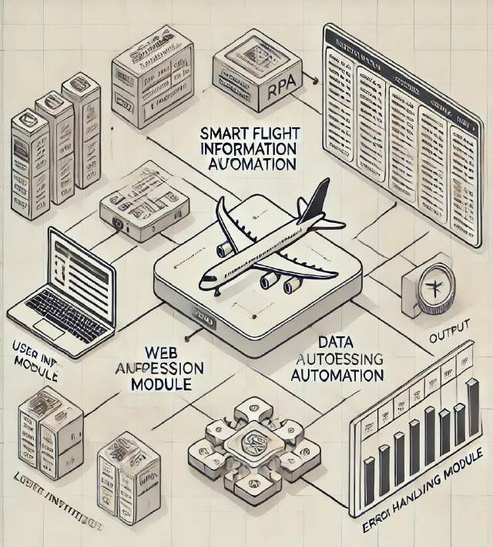
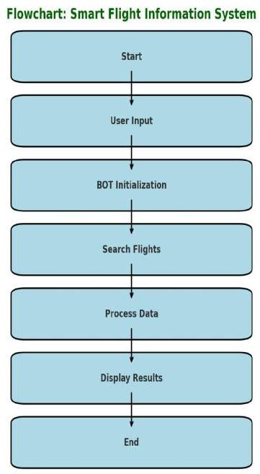
Architecture

Slide 9
System Requirements
Hardware Requirements:
Processor: Minimum Intel Core i5 or equivalent
RAM: At least 8 GB
Storage: 256 GB SSD or higher
Display: Full HD resolution support
Network: Stable internet connection for web scraping and data retrieval
Software Requirements:
Operating System: Windows 10 or higher
RPA Tool: UiPath Studio (Community or Enterprise Edition)
Development Environment: .NET Framework (for UiPath dependencies)
Database: Microsoft Excel or other spreadsheet software (for storing retrieved data)
Browser: Google Chrome or Mozilla Firefox (compatible with UiPath extensions)

Slide 10
Functional Description
Module 1: User Input Module
Collects travel details like destination, dates, and preferences.
Validates inputs for accuracy and prompts for corrections if needed.
Module 2: Web Automation Module
Automates retrieval of flight details from travel websites.
Extracts flight schedules, prices, and airline information with error-handling mechanisms.

Slide 11
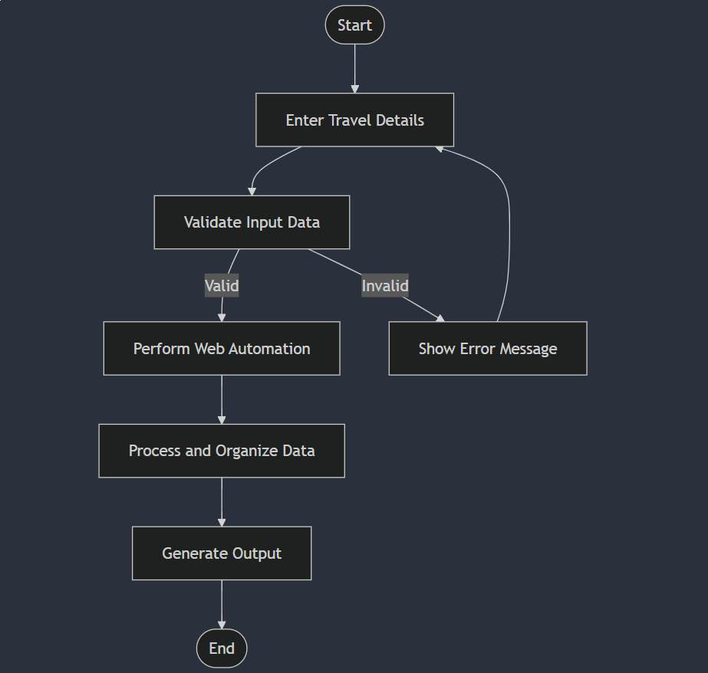
Functional Description

Slide 12
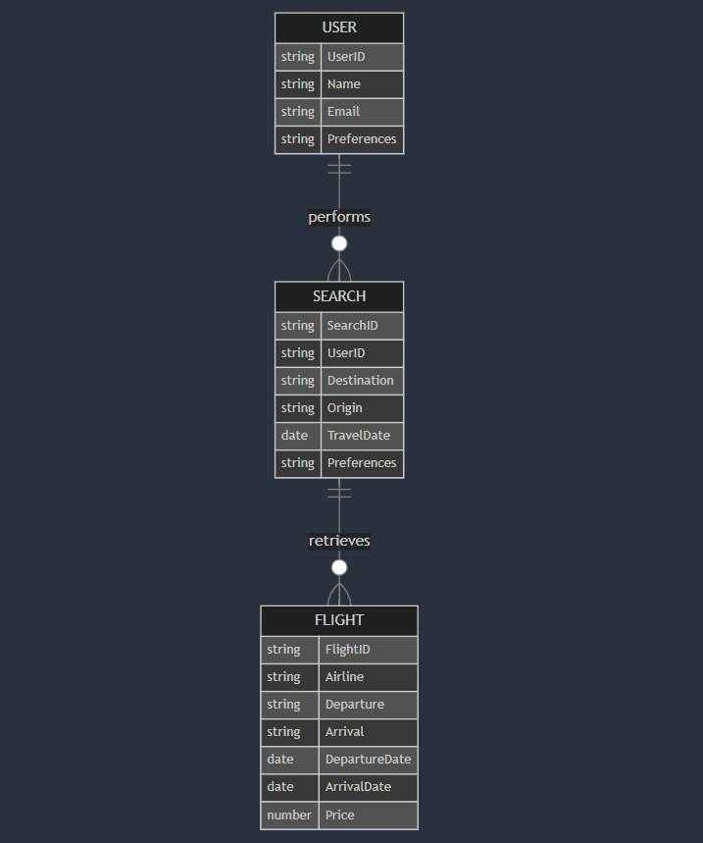
Table Design

Slide 13
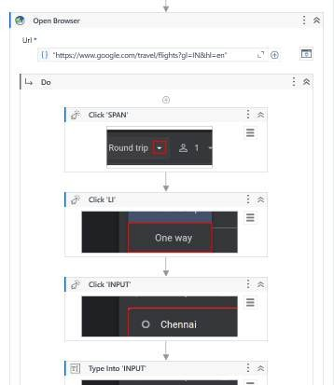
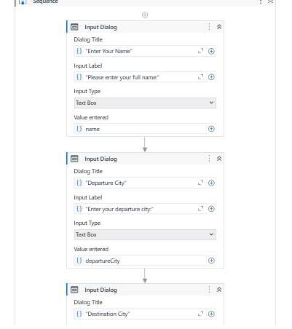
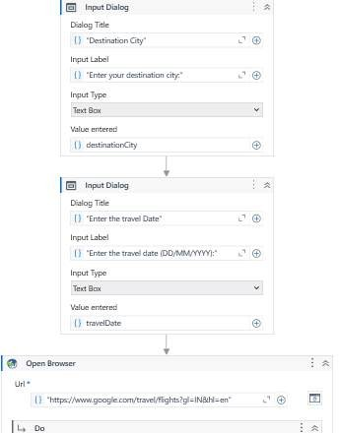
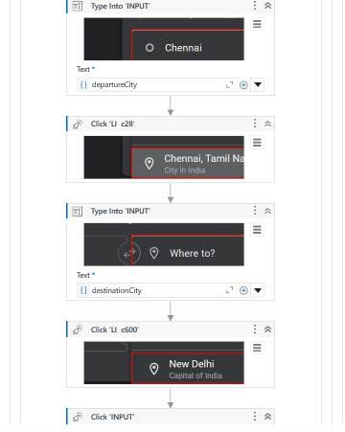
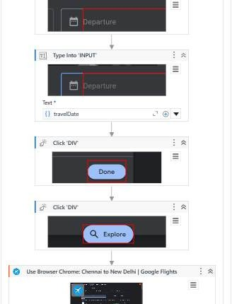
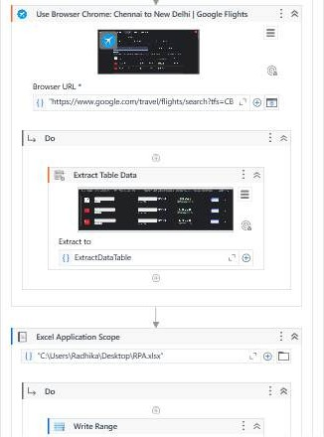
Implementation

Slide 14
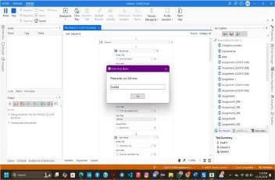
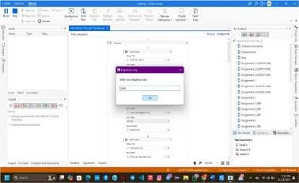

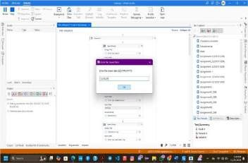

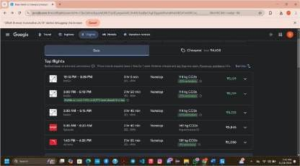
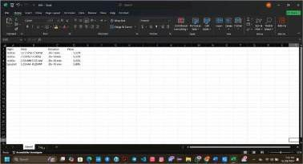
Testing

Slide 15
Conclusions
The Smart Flight Information System demonstrates the transformative potential of Robotic Process Automation (RPA) in simplifying complex and repetitive tasks, such as retrieving and organizing flight information. By automating the processes of data collection, validation, and presentation, the system significantly reduces manual effort, minimizes errors, and improves overall efficiency. Its user-friendly interface and ability to handle dynamic online environments make it a valuable tool for individual travelers and travel agencies alike. This project not only highlights the advantages of automation in the travel industry but also lays the foundation for future enhancements that can further improve scalability, accuracy, and user experience.

Slide 16
Future Enhancement
Integration with Real-Time APIs
Implement APIs from airlines and travel aggregators to fetch real-time flight data for more accurate and up-to-date results. This will eliminate dependence on web scraping and enhance the system's reliability and performance.
Multilingual and Currency Support
Expand the system to support multiple languages and regional currencies, catering to a broader audience.
This feature can improve usability for international travelers by providing localized results.

Slide 17
References
V. Patil, D. Mane, and D. Patil, “Social innovation in education system by using robotic process automation (RPA),” International Journal of Innovative Technology and Exploring Engineering (IJITEE), vol. 8, no. 4, pp. 3757–3760, 2019.
K. Elkhatat, A. M. Elsaid, and S. Almeer, “Evaluating the efficacy of automation and RPA in dynamic industries,” International Journal of Emerging Trends in Engineering Research, vol. 9, no. 10, pp. 3775– 3780, 2020.
H. Alamleh et al., “Enhancing web scraping and data automation with AI-powered algorithms,” Systems Information Engineering Symposium Proceedings, 2023.
N. Meuschke and B. Gipp, “Data structuring and validation for automated systems,” ACM Computing Surveys, vol. 52, no. 6, pp. 1–42, 2019.
UiPath Documentation, “UiPath Automation Platform Overview,” available at https://www.uipath.com/, accessed November 2024.
H. Choudhury and D. Bhattacharyya, “Web scraping challenges and techniques,” Knowledge, Library and Information Networking Proceedings, 2018.
S. Kuppusamy, “Robotic process automation in dynamic data environments,” International Journal of Emerging Technologies in Engineering, vol. 7, no. 3, pp. 125–130, 2020.
T. Foltýnek, “User-centric design in automated systems for data retrieval,” Educational Integrity Symposium Proceedings, 2019.

Slide 18

Queries

Slide 19

Demonstration

Slide 20

Thank You

